Slide 1
Devops Development Model
Presented by:
CG Team

Slide 2
Agenda
Evolution of software development
Scrum Framework Overview
Support Proposed solution
Scrumban methodology solution
Devops

Slide 3
Evolution of software development
Traditional Waterfall Model
Best suited when
Complete requirements are clear and fix.
Product definition is stable
Agile development
Best suited when
Requirement change frequently.
Development needs to be fast.
Devops Approach
Best suited when
Requirement change frequently.
Development needs to be agile.
Operations needs to be agile.

Slide 4
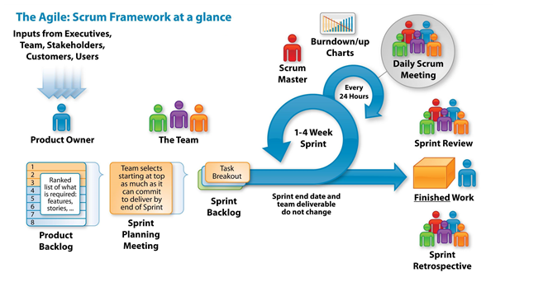
SCRUM FRAMEWORK AT GLANCE

Slide 5
SCRUM ROLES
Functional Contacts
Scrum Master
Team
Paul/ Sitara
Global
Meera
Indonesia and Thailand
Emily
Malaysia
Suvarna Dmello
Development:
Hita Soni
Tejashree Bhagat
Prajna
Business Analyst:
Sathyaraj Rajasekar
Testing:
Kannan & team
Notes:
SME – From Rohit

Slide 6

INITIAL PROCESS
Problem management Tickets/Enhancements
Create Product Backlog
Prioritize User stories as per business value
Requirements is to be done by the product owner with the help of BA, Customer, Stakeholders and users
Creation of User Stories with acceptance criteria
Sprint Planning
Role in the process:
Requirement related to problem management in ServiceNow and enhancements for the SDT application will be added into the Rally tool as a user story along with acceptance criteria to create product backlog by Product owner.
Information can be put together with the help of BA, stakeholders, customers and users.

Slide 7
SPRINT PLANNING
Conducted at the beginning of the sprint
Time box: 4 hours for 2 week sprint
Participants: Product Owner, Scrum Master, Scrum Team
Meeting is split into 2 What and How.
What: Participants: Product Owner, Scrum Master, Scrum Team
We can get explanation on what should we build from PO from list of prioritize user stories. Outcome: Sprint Goal.
How: Participants: Scrum Master, Scrum Team .
We discuss how the work will be completed by splitting the user stories into small tasks. Outcome: Sprint Backlog
Iteraion1 will be created in rally by moving some of the stories from Product backlog to sprint backlog and sprint starts.

Slide 8
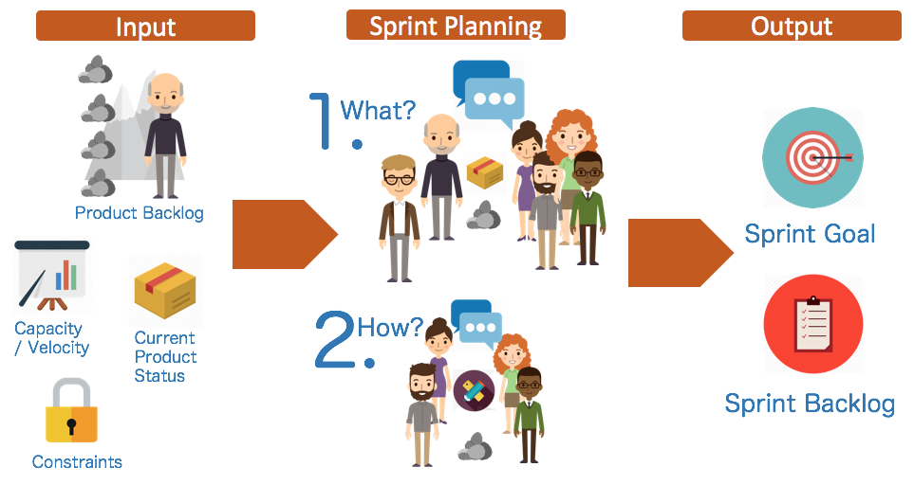
Sprint Planning Meeting
.

Slide 9
DEFINITION OF DONE (DOD)
Code Refactoring
Code review
Unit , Integration and Regression testing
User Acceptance testing
Release notes
TDD for functionality.

Slide 10
SPRINT EXECUTION
During Sprint execution if we have any queries we will clarify that with the product owner.
For development practices we will be using XP practices.
Team will perform unit testing, integration testing along with the coding.
Defect mechanism during following environments
Development – Rally
Stage – ALM
Production –Service now
Once the development stage is tested we will move the build to stage for testing and any defects found will get loaded in ALM.
Based on the Release on production every quarter we will be integrating 4-5 sprints and will get deployed on production with the help of web Coe team after getting approval from Validation Manager.

Slide 11
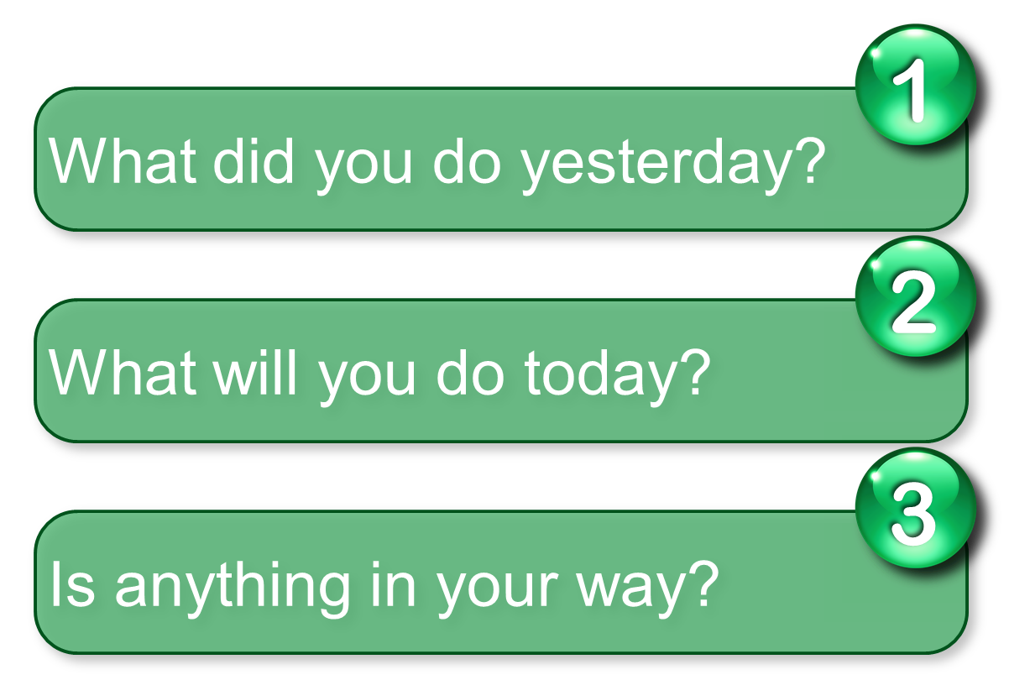
DAILY SCRUM MEETING
Participants: Development Team, Scrum Master ,Product owner(optional)
Duration: Daily 15-minute.
As SDT team members are co located at Mumbai, Bangalore and Chennai we will have scrum call over WebEx and audio bridge.
Held at the same time and place each day to reduce complexity
Everyone answers 3 questions

Slide 12
SPRINT REVIEW MEETING
Participants: Product Owner, Development team, Scrum Master and other stakeholders.
Duration: 2 hours for 2 week sprint
When: At the end of each sprint.
Agenda:
We will showcase live product demonstration to product owner and stakeholders.
Product owner declares what is done.
Once we received feedback from customer and stakeholders which may result in new product backlog items.

Slide 13
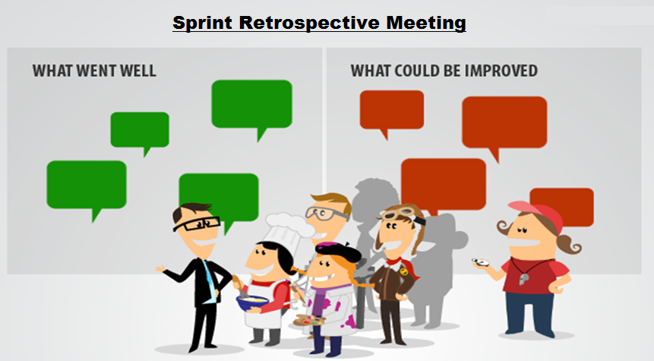
SPRINT RETROSPECTIVES
Participants: Development team, Scrum Master , PO(optional)
Duration: 1.5 hours for 2 week sprint( or less for shorter sprints)
When: At the end of sprint.(After Sprint Review)
Agenda:
We will Inspect and
adapt regarding the
SDT application
Process and environment.

Slide 14
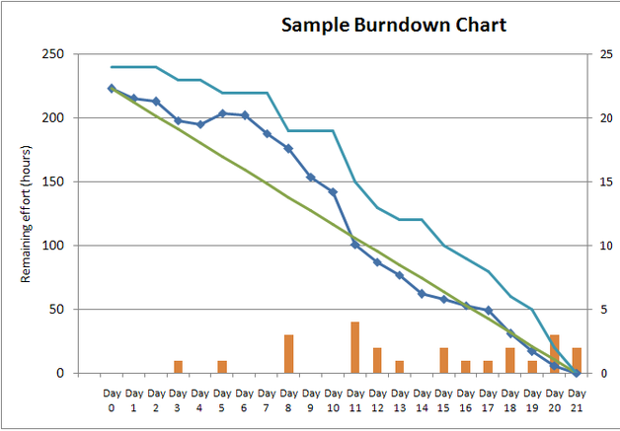
BURNDOWN CHART
A Burndown Chart shows the actual and estimated amount of work to be done in a sprint. It helps track the total work remaining and to project the likelihood of achieving the sprint goal.
A display of what work has been completed and what is left to complete
one for each developer or work item
updated every day.
(make best guess about hours/points
completed each day)
Variation: Release burndown chart
shows overall progress
updated at end of each sprint

Slide 15
Support – Proposed solution Kanban
Kanban, an Agile framework best suited for projects running on support mode. This will allow team to focus all time and energy on delivering value to customer.
Benefits
Manage changing priorities
Increased productivity
Improved visibility
In Kanban :
No Iteration
No special role
No special meeting except daily stand up
No big Transformation

Slide 16
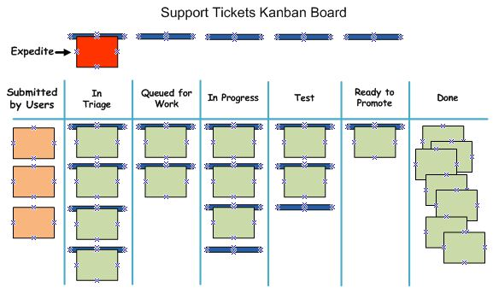
Kanban Board

Slide 17
The Scrumban Methodology solution
Combines the best features of both Scrum and Kanban
Can be used for development and support and maintenance projects.
Utilize Scrum-like iteration planning and iterations process, by incorporating Kanban pull features for production issues.
Production issues, small changes needed to quick fix.
When to consider Scrumban:
Development Projects
Maintenance Projects / Production Support Projects
Where frequent, intermittent changes are needed
If Scrum is challenged by workflow issues, resources and processes

Slide 18
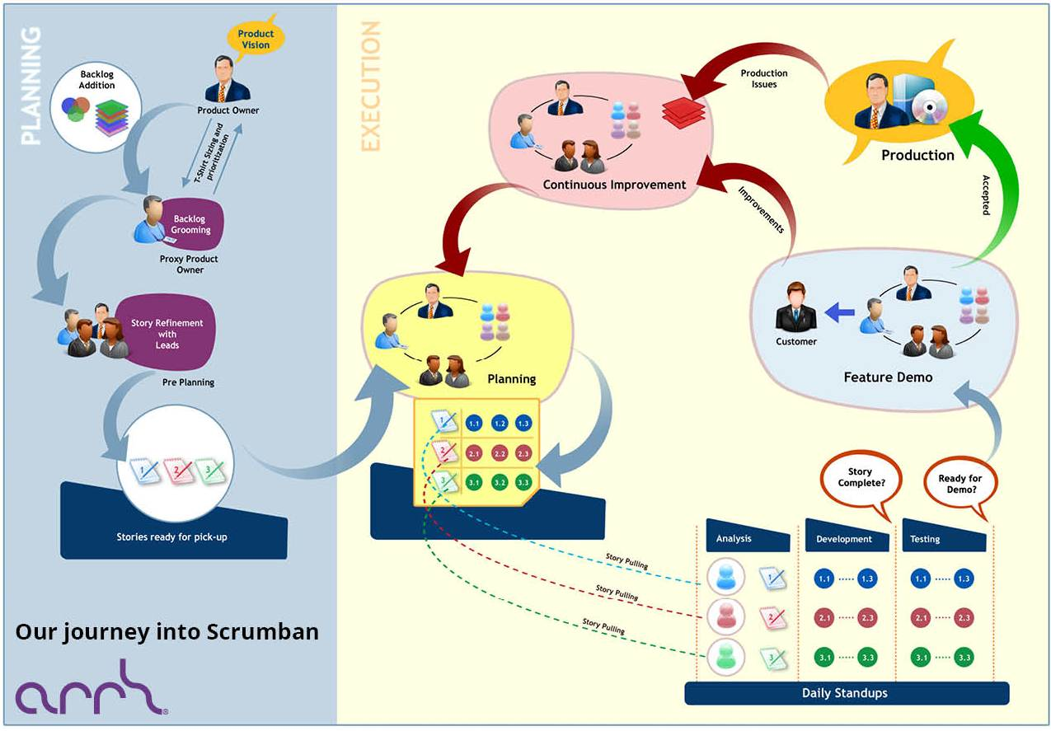
Scrumban framework overview

Slide 19


DEVOPS
What is DevOps?
Remove the gap / break the wall between development and operations
Enable collaboration between them to work together to achieve business goals.
Need for DevOps:
Often, when the Dev team creates the solution, the functional requirements are given full attention but deployment and support requirements are not comprehensive.
This leads to surprises during application deployment and production support.

Slide 20
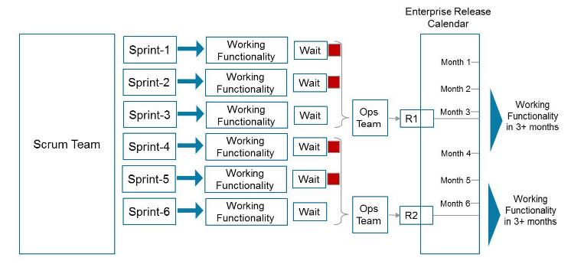
The need for DevOps
Scenario
In an Agile scenario, the development team produces working functionality at the end of every sprint.
However, the completed functionality would have to wait until the release date arrives. Even on the release date, if the Ops team is not prepared for integration and deployment or business is not ready to go live with the new functionality, there will be release delays.
DevOps is a model that is being adopted by many IT organizations to address the scenarios described below.

Slide 21
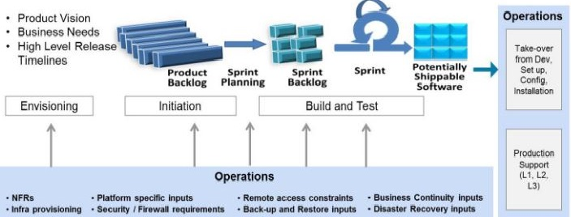
Agile and DevOps
DevOps enables realization of the benefits of faster delivery of functionality achieved through Agile.
Continuous involvement of the Ops team
A fundamental requirement :Ops team is continuously engaged with the development team throughout the life cycle of solution development.
They should also contribute to determining the solution's technical and schedule feasibility.
From the visioning stage through the development stage, the Ops team should provide the necessary inputs to the development team in order for them to build and validate the Ops-related requirements.

Slide 22
Ops representation in the team
Product Owner
Product backlog
Non Functional Requirements
Deployment and support platforms
Their availability and limitations
Dependency on vendor partners on infrastructure maintenance
Third-party interfaces/applications needed for the final solutions
The PO is not expected to be an expert in these areas but should be able to foresee such requirements and communicate these to the appropriate stakeholders in IT and the business.
In addition to the functional requirements, the backlog should Include NFR’s
Performance requirements
Tech requirements related to deployment and support
Requirements to develop the guidelines for rapid rollback and roll forward.
Security/firewall requirements
Sprint Ceremonies
Sprint planning and daily stand-up:
Include the Ops team during sprint planning and in selected daily stand-ups where the team would discuss Ops aspects.
Sprint Review:
if the Ops team is part of the demos, they have an opportunity to see what is coming up and provide inputs for the subsequent sprints to improve the product and include Ops requirements as well.
Definition Of Done(DOD)
Specific support instructions as part of the documentation.
Dry run of instructions
production multi-environment testing

Slide 23
Tools
Continuous Integration: Jenkins, Bamboo,Teamcity
Versioning : Git, SVN,TFS

